Slide 1


Insurance Coverages -- what policies respond to pandemic related incidents
Friday, March 27, 2020

Slide 2
Supporting Business Continuity for the Specialty & Fine Chemical Industry
Daily Updates: https://www.socma.org/covid-19/
Tuesday Townhalls at 1:00pm Eastern.
Thursday Bulletins with industry updates.
Friday Webinars on business continuity topics.
  OSHA compliance, legislative updates and supply chain disruption to come.
Engaged and available staff to bounce ideas with or discuss disruption concerns: info@socma.org

Slide 3
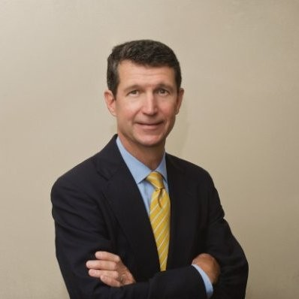
Today’s Expert:
John Blythe
Executive Vice President
Jbly@McGriff.com
205-581-9232

Slide 4
Areas of potential risk
Revenue Loss
Property Damage
Actual presence of virus on site
Employment Issues
Worker’s Compensation Claims
3rd Party Liability
Clients and visitors
Decontamination and cleanup
Governmental requirements
Product
Governmental required shutdown
Inability to obtain raw materials, supplies, or to ship product
Lack of business
Inability to produce due to required decrease in employees

Slide 5
Potential Sources of Insurance Coverage
Property and Business Interruption
  Property policy to provide coverage, there must be “direct physical loss or damage” to covered property from a covered peril.
  Likewise, for Business Income and/or Contingent Business Income coverage to trigger, there typically must be “direct physical loss or damage”.
  Many policies contain a coverage grant for Civil Authority, but this grant of coverage typically requires the shutdown to be the result of direct physical loss by a covered peril. Likewise, with the Ingress/Egress coverage that many policies contain.

Slide 6
Potential Sources of Insurance Coverage
Environmental Liability
  Environmental policies vary greatly by insurers and the type of risk being covered.
  Some may contain specific grants, outright exclusions, or remain silent related to communicable diseases and viruses.
  Most environmental policies contain some degree of coverage for both third parties (clients, customers, visitors) as well as first party (the insured).
  These policies can potentially respond to some degree of cleanup, legal expenses, decontamination, bodily injury, property damage, or business interruption.

Slide 7
Potential Sources of Insurance Coverage
Workers’ Compensation
  When does workers’ compensation apply.
  The disease is not of a character to which the employee may have had substantial exposure outside employment and to which the general public is exposed.
  Exceptions -- some jurisdictions may grant coverage; if so, the WC policy would respond.

Slide 8
Potential Sources of Insurance Coverage
Commercial General Liability
  Standard Commercial General Liability policies do not contain exclusionary language related to virus or communicable disease.
  Liability resulting from visitors to your premises or the sale of your product.

Slide 9
Potential Sources of Insurance Coverage
Directors and Officers
  Directors and Officers policies may provide coverage for the costs and liabilities arising from shareholder lawsuits alleging that the company failed to act reasonably and plan appropriately.

Slide 10
Looking Ahead
Insurance Market
Claims
Exclusions
Policy Language

Slide 11


Questions and Open Discussion?
Owen P. Jappen
Sr Manager, Industry Relations
ojappen@socma.org
571.348.5105
John Blythe
Executive Vice President
Jbly@McGriff.com
205-581-9232

