Slide 1
Logistics & Shipments During Quarantine & Closures
Friday, April 10, 2020

Slide 2
Supporting Business Continuity for the Specialty & Fine Chemical Industry
Daily Updates: https://www.socma.org/covid-19/
Tuesday Townhalls at 1:00pm Eastern.
Thursday Bulletins with industry updates.
Friday Webinars on business continuity topics.
OSHA compliance, legislative updates and supply chain disruption to come.
Engaged and available staff to bounce ideas with or discuss disruption concerns: info@socma.org

Slide 3
Today’s Presenter:
Randy Strutz President rstrutz@qualitydistribution.com
813-569-7191

Slide 4
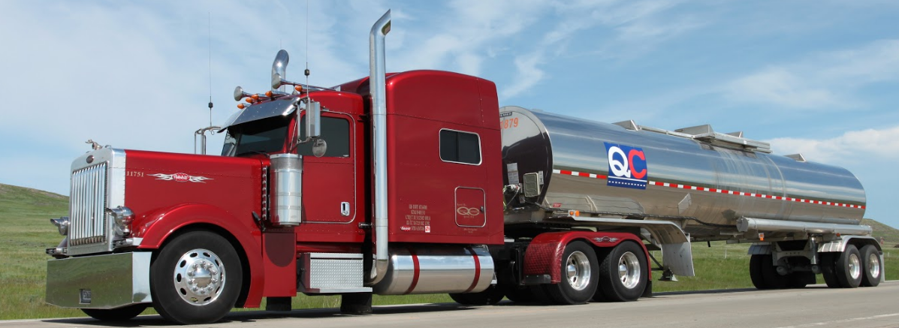
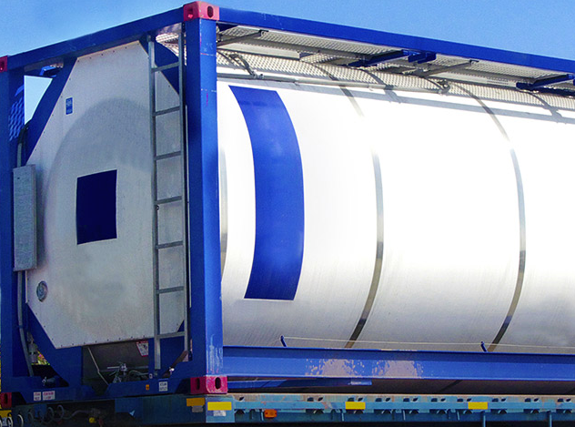
COVID-19 Update for SOCMA
Randy Strutz
President Quality Carriers

Slide 5
Who is Quality Carriers?
Largest chemical bulk carrier in North America
2,800 power units and 8,000 trailers to meet almost any needs and demand surges
100+ facilities in U.S., Canada and
Complete North American market coverage
One of Safest Carriers in the Bulk Tank Truck Business
Operating to CSA standards since 2007
Cameras being deployed throughout entire North American fleet
$125,000,000 Trucking Liability Insurance
DoT Incident Rate 30% below national average.
Responsible Care Participant (first carrier certified)

Slide 6
COVID-19 Impacts & Actions
Bulk Truck Demand Impacts
Negatives:
Automotive: Coatings, plastics, fluids, other upstream impacts
Latex: Localized impacts in PA
Oil: oil field chemicals, fuel additives
Positives:
Ethanol campaigns for sanitizers
Water treatment
Cleaning & paper product chemicals
Other:
Modal deviations primarily rail
Cross border
Private & small carrier fleet overflow

Slide 7
COVID-19 Impacts & Actions
Bulk Truck Supply Impacts
Government Directives:
Confusion on state/local restrictions for essential services
Border crossing, especially Canada
Hours of Service relief
Driver Availability:
Driver quarantining due to COVID-19 positive tests
Potential exposure impacts
Driver family impacts
Driver testing (respirators)
Driver’s Ability to do their Job:
Transiting virus “epicenter” states
Paperwork
Interaction
Driver Way of Life Impacts
Sanitizers/cleaning supplies
Food
Parking/Overnight stays
Restrooms

Slide 8
COVID-19 Impacts & Actions
Best Practices
Driver Ingress/Egress
Driver surveys – questions about health, fever, exposure
Guard Shack interaction – phones, access pads
Loading/Unloading
Driver assistance?
PPE / gloves / wipes / sprays
Interaction/social distancing
Driver Paperwork
Still part of transportation – BOLs, Delivery Receipts, scale tickets, etc.
Consignee refusal to sign
Shared writing instruments
Reminder:
Drivers are people too! An integral part of your supply chain.

Slide 9
COVID-19 Impacts & Actions
Learnings
Future is uncertain – “uncharted” territory
Lessons are the same from other crises:
Hurricanes
Floods
Railroad outages/strikes/barricades
Plant outages
Have “optionality”
Strong carrier relationships
Carriers who can provide surge capacity and geographic flexibility
Modal shifts, generally to truck from rail/barge
Nimbleness and flexibility are key
Don’t forget about the DRIVER as part of your supply chain

Slide 10
Questions and Open Discussion
Owen P. Jappen Sr Manager, Industry Relations ojappen@socma.org 571.348.5105
Randy Strutz President rstrutz@qualitydistribution.com 813-569-7191

