Slide 1
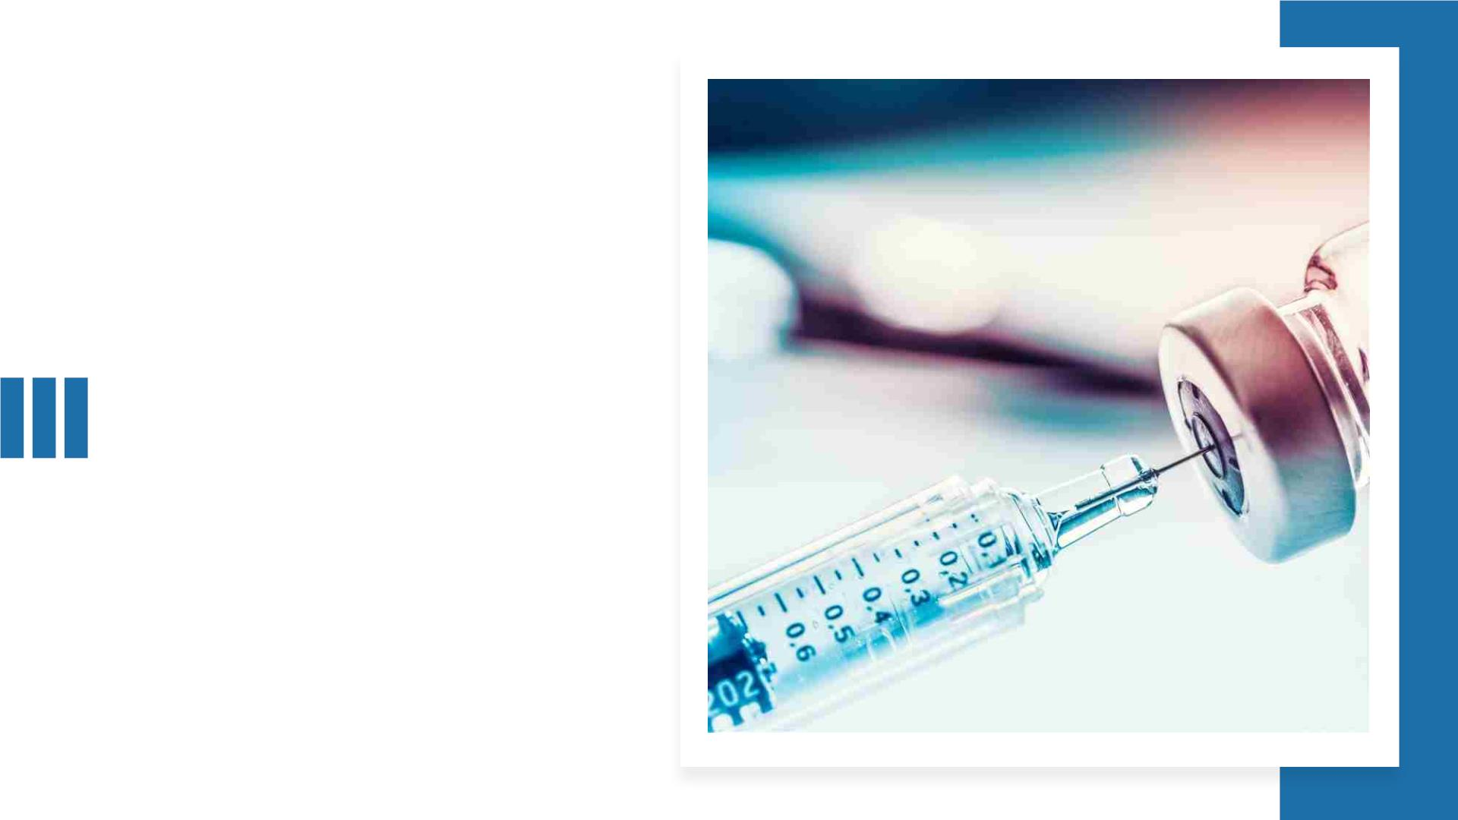
Presenter Name
Company Name
Date
OSHA COVID-19
Vaccine ETS
Implementation

Slide 2

About the ETS
• On September 9, the White House issued an
Executive Order(EO) requiring companies with 100
or more employees to mandate vaccinations (with
health and religious exemptions) or take weekly
COVID-19 tests and wear masks.
• The Occupational Safety and Health Administration
(OSHA) has published an Emergency Temporary
Standard (ETS) to implement this EO.

Slide 3
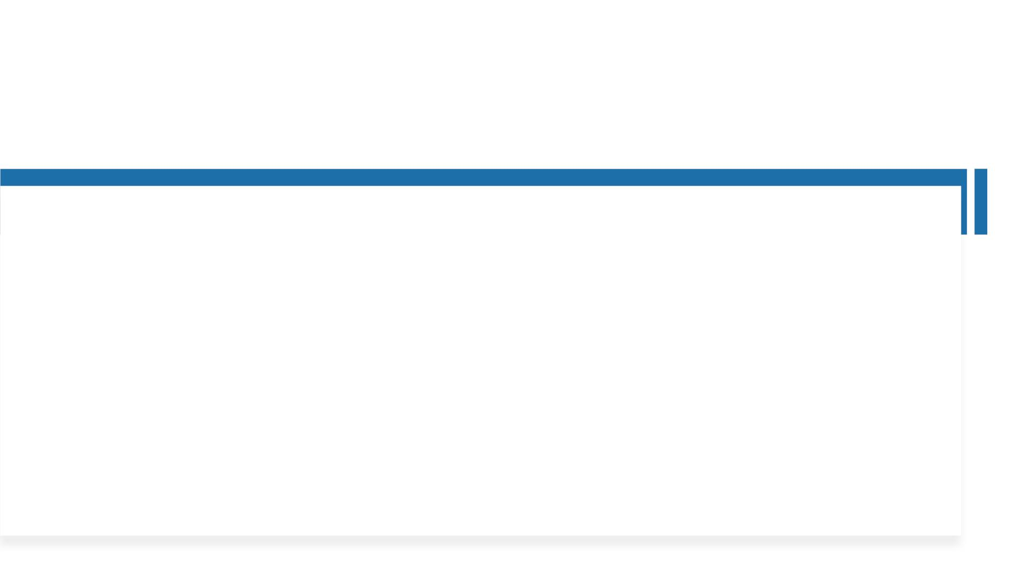
COVID-19 Vaccine Efficacy, Safety & Benefits
According to the Center for Disease Control (CDC):
• Everyone ages 5 and older can get vaccinated against COVID-19. Learn how to find a COVID-
19 vaccine.
• COVID-19 vaccines are effective at helping protect against severe disease and death from the
virus that causes COVID-19, including known variants currently circulating (e.g., Delta variant).
• The benefits of COVID-19 vaccination outweigh the known and potential risks, which are rare.
• As with other routine vaccines, side effects may occur after vaccination. These are normal
and should go away within a few days.
• Additional information is available at CDC’s website

Slide 4
What We Know about How Well COVID-19
Vaccines Are Working
According to the Center for Disease Control (CDC):
• COVID-19 vaccination reduces the risk of COVID-19 and its potentially severe complications.
All COVID-19 vaccines currently authorized for use in the United States helped protect adults
and children 5 years and older against COVID-19, including severe illness, in clinical trial
settings. So far, studies that have looked at how COVID-19 vaccines work in real-world
conditions (vaccine effectiveness studies) have shown that these vaccines are working well.
• Most vaccine effectiveness data now available are related to mRNA vaccines (Pfizer-BioNTech
and Moderna) because these vaccines have been available longer. CDC and other experts
continue to study the effectiveness of both mRNA vaccines and the Johnson & Johnson’s
Janssen (J&J/Janssen) COVID-19 vaccine in real-world conditions.

Slide 5
So Far, Research on mRNA COVID-19 Vaccine
Effectiveness in Real-World Conditions Is Reassuring
According to the Center for Disease Control (CDC):
• Vaccine effectiveness studies provide a growing body of evidence that mRNA COVID-19
vaccines offer similar protection in real-world conditions as they have in clinical trial settings,
reducing the risk of COVID-19, including severe illness by 90 percent or more among people
who are fully vaccinated.
• In addition to providing protection against COVID-19, there is increasing evidence that COVID
-19 vaccines also provide protection against COVID-19 infections without symptoms
(asymptomatic infections). COVID-19 vaccination can reduce the spread of disease overall,
helping protect people around you.

Slide 6
Research Suggests That for mRNA COVID-19
Vaccines, Two Doses Are Better than One
According to the Center for Disease Control (CDC):
• Real-world data from vaccine effectiveness studies have shown that receiving only one dose
of these mRNA COVID-19 vaccines provides some protection against COVID-19, at least in the
short term. These studies have also shown that for mRNA vaccines, two doses provide better
protection than one dose. To receive the most benefit from vaccination, people should get
the recommended number of doses of vaccine.

Slide 7
COVID-19 Vaccines Help Protect against Severe
Illness with COVID-19 Vaccine Breakthrough Cases
According to the Center for Disease Control (CDC):
• While COVID-19 vaccines are working well, some people who are fully vaccinated against COVID-19 will still get sick, because no vaccines
are 100% effective. These are called vaccine breakthrough cases. However, data suggest that vaccination may make symptoms less severe
in people who are vaccinated but still get COVID-19. mRNA COVID-19 vaccines have been shown to provide protection against severe
illness and hospitalization among people of all ages eligible to receive them. This includes people 65 years and older who are at higher
risk of severe outcomes from COVID-19.
• It typically takes about 2 weeks for the body to build protection after vaccination. You are fully vaccinated two weeks after your second
dose of Pfizer -BioNTech or Moderna vaccine and two weeks after your single dose of Johnson & Johnson’s J&J/Janssen vaccine. It is
possible you could still get COVID-19 soon after vaccination because your body has not had enough time to build protection. Keep taking
precautions until you are fully vaccinated.
• People who have moderately to severely compromised immune systems are especially vulnerable to COVID-19, and may not build the
same level of immunity to 2-dose vaccine series compared to people who are not immunocompromised. CDC recommends that people
with moderately to severely compromised immune systems receive an additional dose of mRNA COVID-19 vaccine at least 28 days after a
second dose of Pfizer-BioNTech COVID-19 vaccine or Moderna COVID-19 vaccine. This additional dose is intended to improve
immunocompromised people’s response to their initial vaccine series. They should continue to take all precautions recommended for
unvaccinated people, including wearing a well-fitted mask, until advised otherwise by their healthcare provider.

Slide 8
Variants and Vaccines
According to the Center for Disease Control (CDC):
• FDA-authorized COVID-19 vaccines help protect against Delta and other known variants.
• These vaccines are effective at keeping adults and children 5 years and older from getting
COVID-19, getting very sick, and dying.
• To maximize protection from the Delta variant and prevent possibly spreading it to others,
you should wear a mask indoors in public if you are in an area of substantial or high
transmission even if you are fully vaccinated.
• We don’t know how effective the vaccines will be against new variants that may arise.

Slide 9
COVID-19 Vaccines are Safe, Including for
Children Ages 5 Years and Older
According to the Center for Disease Control (CDC):
• Millions of people in the United States have received COVID-19 vaccines since they were authorized for emergency use by FDA.
• COVID-19 vaccines have undergone and will continue to undergo the most intensive safety monitoring in U.S. history. Learn more about how
federal partners are continuing to closely monitor vaccine safety.
• A growing body of evidence has shown that these vaccines are safe and effective.
• COVID-19 vaccines were developed using scientific methods that have been around for decades.
• Before recommending COVID-19 vaccination for children, scientists conducted clinical trials. The FDA gave the Pfizer BioNTech COVID-19 vaccine
emergency authorization to use in children ages 5 years through 15 years and full approval to use in people ages 16 years and older. Learn more
about the process of developing, authorizing and approving COVID-19 vaccines.
• Some people have no side effects from COVID-19 vaccines. Many people have reported side effects that may affect their ability to do daily
activities, but they should go away within a few days.
• There is no evidence that COVID-19 vaccines cause fertility problems.
• The benefits of COVID-19 vaccination outweigh the known and potential risks. Reports of adverse events, like allergic reactions or myocarditis or
pericarditis, are rare.
• Everyone who receives a COVID-19 vaccine can participate in safety monitoring by enrolling themselves and their children ages 5 years and older
in v-safe and completing health check-ins after COVID-19 vaccination. Parents and caregivers can create or use their own account to enter their
children’s information.

Slide 10
COVID-19 Vaccines are Effective
According to the Center for Disease Control (CDC):
• COVID 19-vaccines are effective and can reduce the risk of getting and spreading the virus that causes
COVID-19. Learn more about the different COVID-19 vaccines.
• COVID-19 vaccines also help children and adults from getting seriously ill even if they do get COVID-19.
• There are approximately 28 million children between the ages of 5 and 11 years old in the United States,
and there have been nearly 2 million cases of COVID-19 within this age group during the pandemic. COVID-
19 can make children very sick, require hospitalization, and some children have even died. Children with
underlying medical conditions are more at risk for severe illness compared to children without underlying
medical conditions.
• Getting children ages 5 years and older vaccinated can help protect them from serious short- and long-term
complications.
• Getting everyone ages 5 years and older vaccinated can protect families and communities, including friends
and family who are not eligible for vaccination and people at increased risk for severe illness from COVID-19.

Slide 11
COVID-19 Vaccine Efficacy, Safety & Benefits
According to the Center for Disease Control (CDC):
• People who are fully vaccinated can resume many activities they did before the pandemic. However,
people should wear a mask indoors in public if they are in an area of substantial or high transmission.
• People who are moderately to severely immunocompromised are recommended to get an additional
primary dose of an mRNA COVID-19 vaccine (i.e., Pfizer-BioNTech or Moderna).
• Unlike many medications, COVID-19 vaccine dosage does not vary by patient weight but by age on the
day of vaccination.
• People can get a COVID-19 vaccine and other vaccines, including flu vaccine, at the same time.
• NOTE TO EMPLOYERS: You must provide employees a copy of the following CDC publication:
https://www.cdc.gov/coronavirus/2019-ncov/vaccines/keythingstoknow.html

Slide 12

How Company Name is Implementing
the ETS
• Company Name has developed a policy to comply with this ETS and will be
reviewing it with you today.

Slide 13
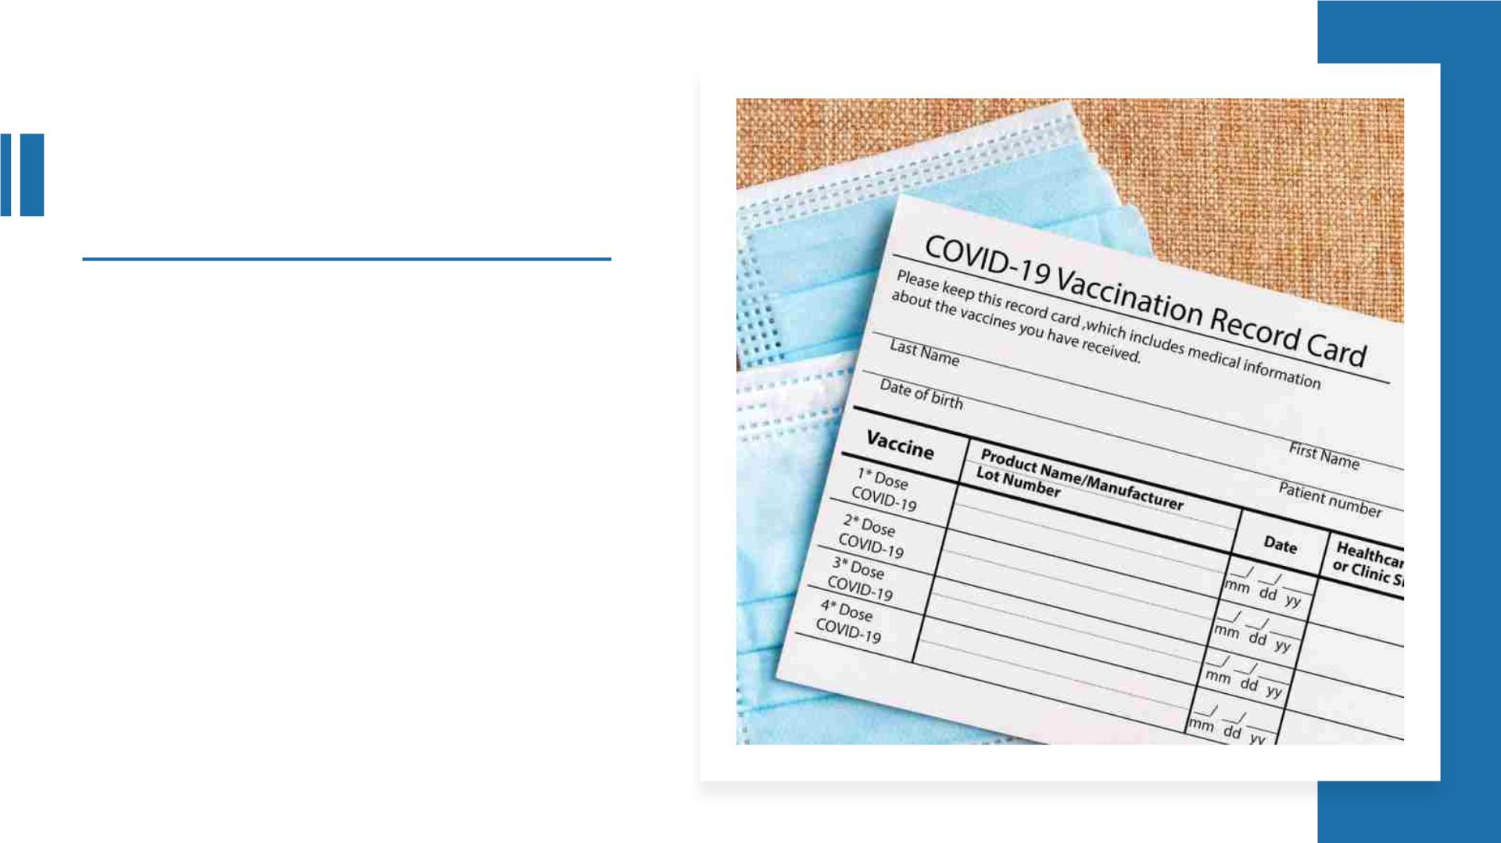
Employee Vaccination
Records
• The ETS requires Company Name to
determine the vaccination status of
each of our employees.
• Each vaccinated employee must provide
acceptable proof of vaccination status,
including whether they are:
• Fully vaccinated
• Partially vaccinated.
• Unvaccinated because of medical
or religious reasons.
• Unvaccinated.

Slide 14

Employee Vaccination Records
• Acceptable proof of vaccination status:
• The record of immunization from a health care provider or pharmacy.
• A copy of the COVID–19 Vaccination Record Card.
• A copy of medical records documenting the vaccination.
• A copy of immunization records from a public health, state, or tribal
immunization information system.
• A copy of any other official documentation that contains the type of
vaccine and the date(s) administered, the name of the health care
professional(s) or clinic site(s) administering the vaccine(s).
• In the case of a lost or damaged proof of vaccination status, a signed and
dated statement by the employee.

Slide 15

Record Requests
• Employees are entitled to
request a copy of the vaccine
records that company name is
maintaining in order to comply
with this ETS.
• To request a copy of their
records, employees should
(describe the procedures to be
used for requesting records).

Slide 16
Company Name’sVaccination Policy
• Describe the company’s vaccination policies and procedures established to
implement the ETS.

Slide 17
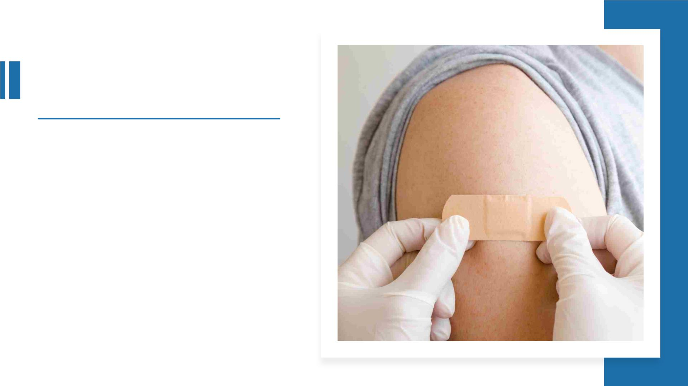
Paid Leave and Time to
Recover
• The ETS requires Company Name to
provide employees up to 4 hours of
paid time, including travel time, at your
regular rate of pay to receive each
primary vaccine dose.
• The ETS requires Company Name to
provided reasonable time and paid sick
leave to recover from side effects
experienced following any primary
vaccination series dose.
• Describe company’s policy for
“reasonable time and paid sick leave”.

Slide 18
Company Name’sCOVID-19 Testing Policy
• If your company is offering the option of testing and face coverings for unvaccinated employees, describe the
company’s COVID-19 testing policies and procedures established to implement the ETS. Per the ETS:
• Employers must ensure that each employee who is not fully vaccinated and reports at least once every
seven days to a workplace where other individuals (e.g., coworkers, customers) are present:
• Is tested for COVID–19 at least once every seven days;
• and provides documentation of the most recent COVID–19 test result to the employer no later than
the 7th day following the date on which the employee last provided a test result.
• Employers must ensure these unvaccinated employees are tested at least once every seven calendar days,
regardless of their work schedule.

Slide 19
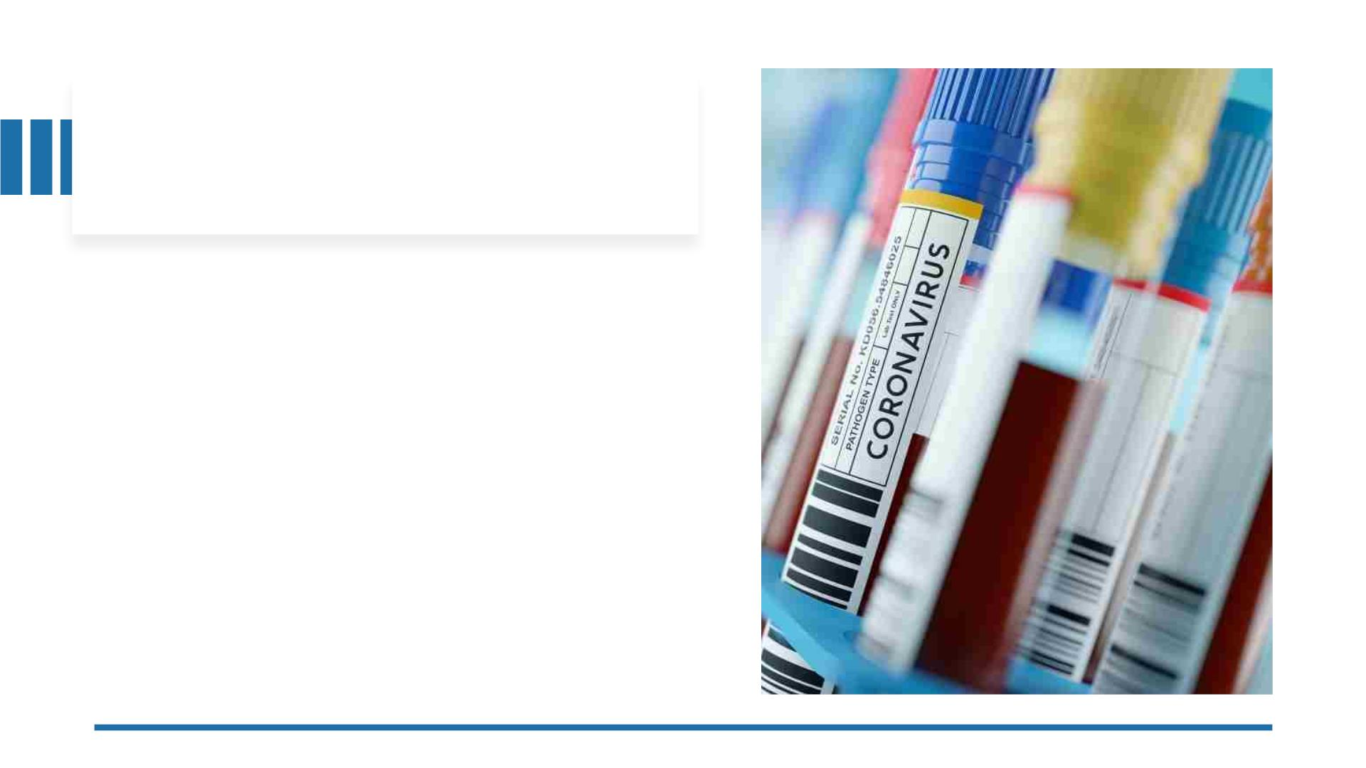
Notifying Company Name of a
Positive COVID-19 Test or Diagnosis
• Describe the company’s policy and procedures that employees
need to follow to provide notice of a positive COVID–19 test or
diagnosis of COVID–19 by a licensed healthcare provider. Per
the ETS:
• Each employee who is COVID–19 positive must notify the
employer of their COVID–19 test result or diagnosis
‘‘promptly.’’
• For employees who are not at the workplace when they
receive a positive COVID–19 test result or diagnosis,
‘‘promptly’’ notifying the employer means notifying the
employer as soon as practicable before the employee is
scheduled to start their shift or return to work.
• In the event that the employee is in the workplace when
they receive a positive COVID–19 test result or diagnosis
of COVID–19, ‘‘promptly’’ notifying the employer means
notifying the employer as soon as safely possible while
avoiding exposing any other individuals in the workplace.

Slide 20
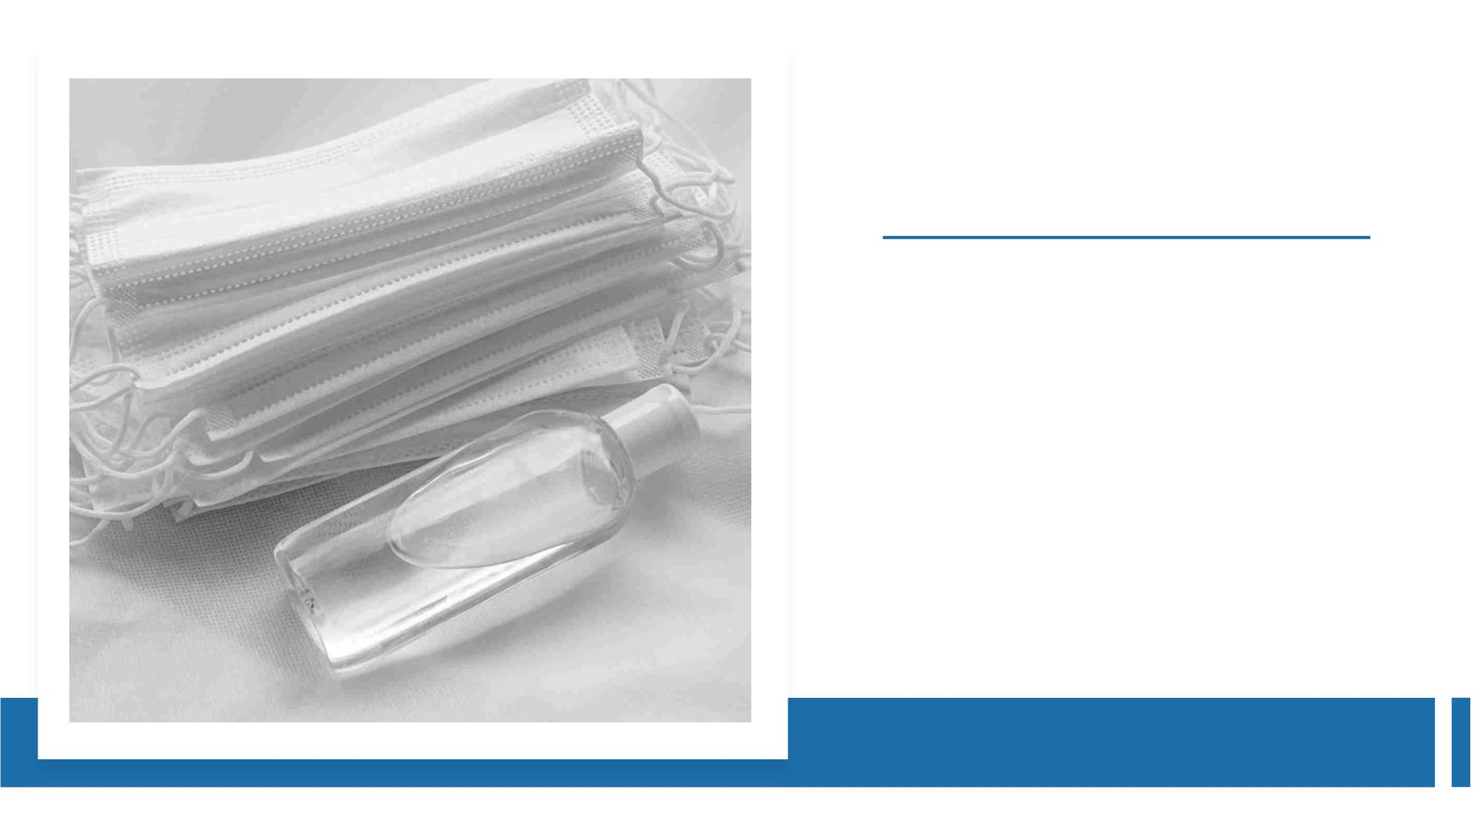
Company Name’s
Face Covering Policy
•
If your company is offering the option of testing and face coverings
for unvaccinated employees, describe the company’s face covering
policies and procedures established to implement the ETS. Per the
ETS, employees must wear a face covering, except:
•
•
•
When an employee is alone in a room with floor to ceiling
walls and a closed door.
For a limited time while the employee is eating or drinking
at the workplace.
For a limited time for identification purposes in compliance
with safety and security requirements.
•
•
When an employee is wearing a respirator or facemask.
Where the employer can show that the use of face coverings
is infeasible or creates a greater hazard that would excuse
compliance with this paragraph (e.g., when it is important
to see the employee’s mouth for reasons related to their job
duties, when the work requires the use of the employee’s
uncovered mouth, or when the use of a face covering
presents a risk of serious injury or death to the employee).

Slide 21

• Employees are protected from retaliation
for engaging in activities protected by OSHA
statute or regulation.
• You are protected from:
Protection
from
•
Discipline
• Reducing your pay or hours
• Reassignment to a less desirable
position
Employer
Retaliation
• Denying overtime or promotion
• Intimidation or harassment
• Any other action that would stop you
from raising concerns about possible
violation or engaging in other protected
activity

Slide 22

Laws Against Employer Retaliation
Prohibits employers from discharging or in any manner
discriminating against any employee for reporting a work-related
injury or illness.
Section
1904.35(b)(1)(iv)
Prohibits employers from discriminating against employees for
exercising rights under, or as a result of actions required by, the
ETS.
Section 11(c) of
the OSH Act
Section 11(c) of
the OSH Act
Protects employees from retaliation for filing an occupational safety or health
complaint, reporting a work-related injury or illness, or otherwise exercising
any rights afforded by the OSH Act.

Slide 23

Criminal Penalties - Knowingly
Supplying False Statements Or
Documentation
If you make false statements
or submit false documents or
records, you face criminal
penalties, including fines or
jail time.

Slide 24
Criminal Penalties - Knowingly Supplying
False Statements Or Documentation
• 18 U.S.C. 1001 provides for fines of up to $250,000 or imprisonment of up to
5 years for any person who ‘‘in any matter within jurisdiction’’ of the
executive branch of the U.S. Government ‘‘knowingly and willfully’’ engages
in any of the following:
• Falsifies, conceals, or covers up by any trick, scheme, or device a material
fact;
• Makes any materially false, fictitious, or fraudulent statement or
representation; or
• Makes or uses any false writing or document knowing the same to
contain any materially false, fictitious, or fraudulent statement or entry.

Slide 25
Criminal Penalties - Knowingly Supplying
False Statements Or Documentation
• Section 17(g) of the OSH Act provides for fines up to $10,000,
and imprisonment for not more than six months, or both, for
anyone who:
‘‘knowingly makes any false statement, representation, or
certification’’ in any application, record, report, plan, or other
document ‘‘filed or required to be maintained pursuant to this
chapter.’’

Slide 26

Questions or Further
Information
• For any questions or additional information,
please contact:
• Name, Title
• Email
• Phone
• To obtain a copy ofCompany Name’s policies
implementing the OSHA COVID-19 Vaccine ETS
or to obtain a copy of this presentation, please
contact:
• Name, Title
• Email
• Phone

